Slide 1
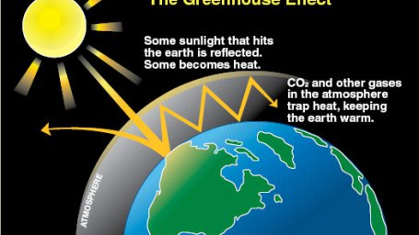
Green Fault Lines

Slide 2
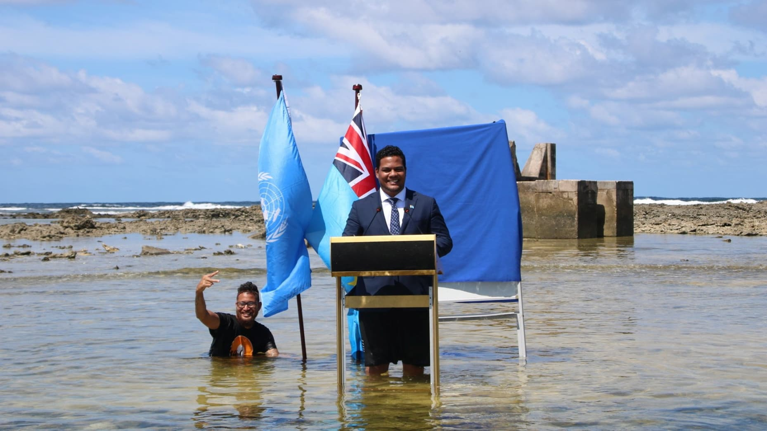
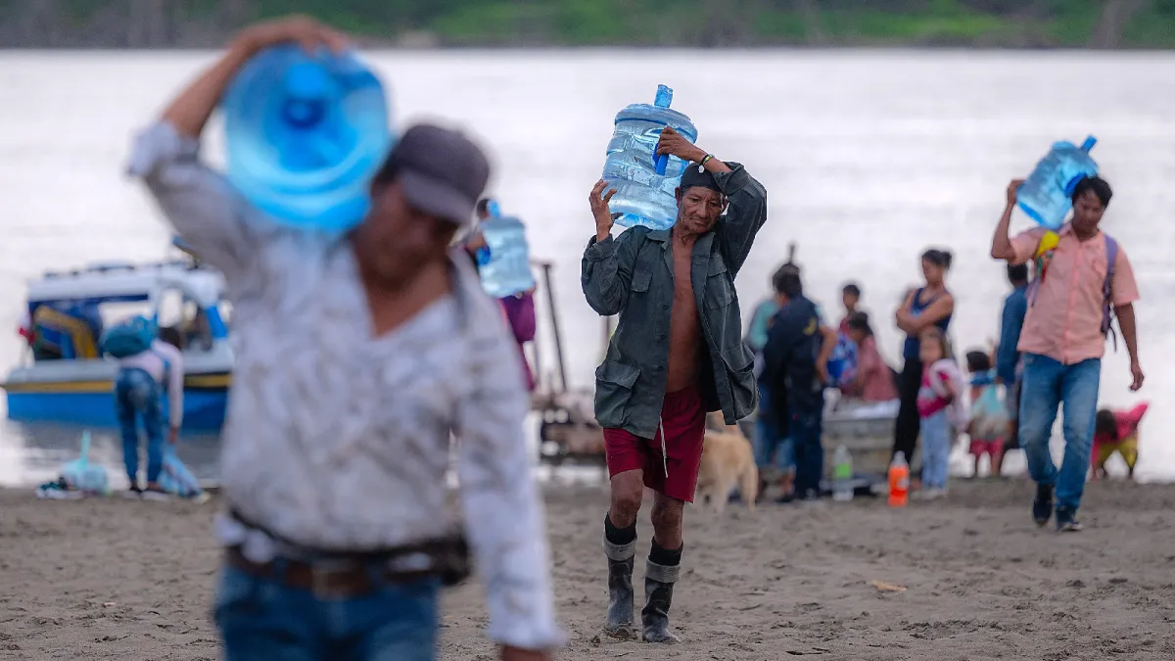
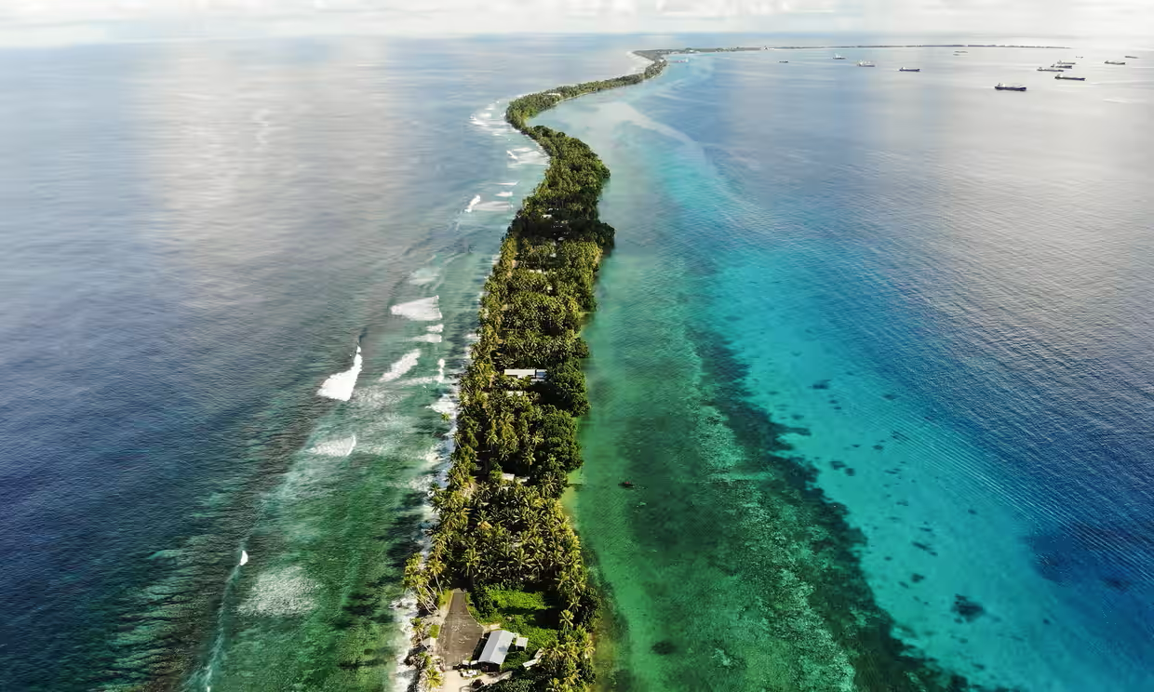
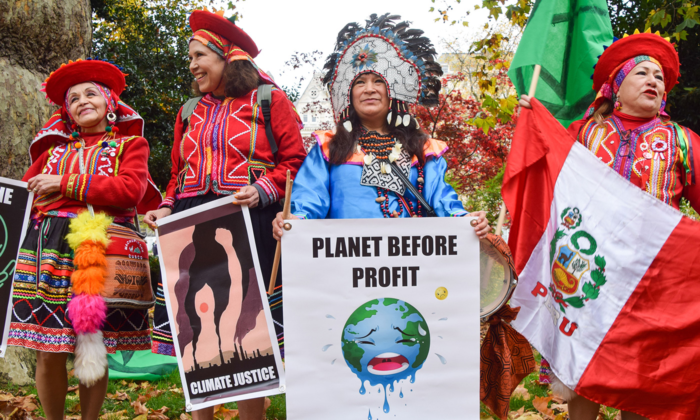
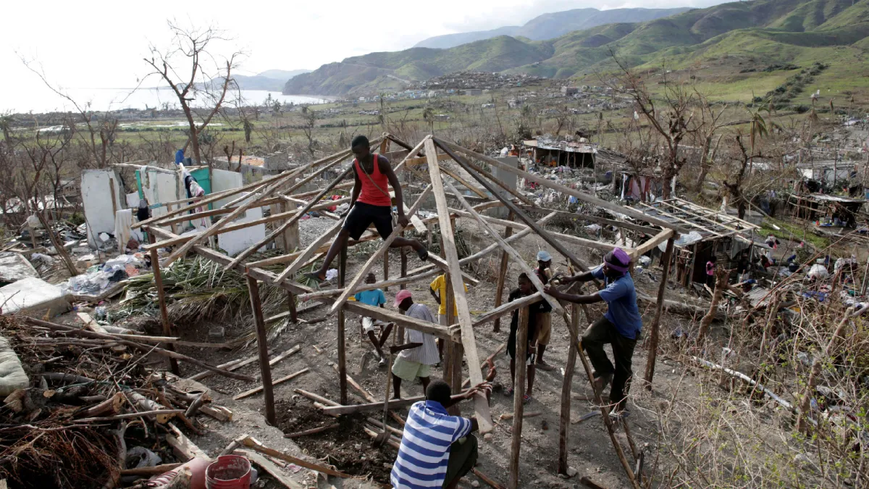
Faces of Climate Change

Slide 3
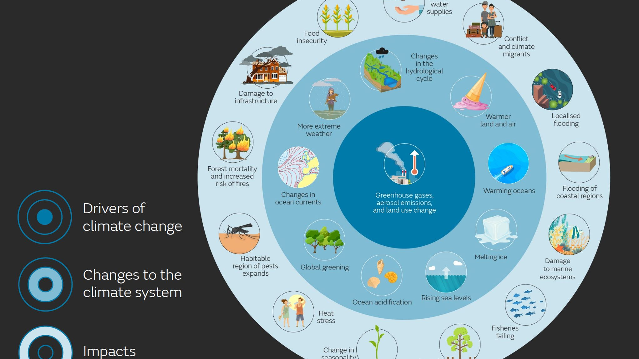
Climate Change is a Multi-Faceted Problem that Requires a Multi-Faceted Approach.

Slide 4
Projects for All Levels!
Beginner Level: Public Perception and Opposition to Climate Change and Adaptation Policies
Intermediate to Advanced: International Collective Action on Climate Change
Specialized-Advanced: Climate Change and Conflict

Slide 5
Public Perception and Opposition to Climate Change and Adaptation Policies
Policy Effectiveness and Implementation
Combating Misinformation and Political Polarization
Enhancing Adaptive Capacity and Resilience

Slide 6
Research Questions
Why do some people oppose climate change?
Do cognitive/emotional appeals make people more likely to believe in climate change?
How do personal experiences with extreme weather events affect individuals’ beliefs about climate change?
How do political ideologies correlate with climate change denial or acceptance?
What is impact of disinformation campaigns on public opposition to climate change?
What explains public support for climate change adaptation?
How do perceived personal risks influence support for climate adaptation measures?
Are economic incentives effective for public willingness to adopt climate adaptation strategies?
How do trust in government and institutions impact support for climate adaptation policies?
How do demographic factors (e.g. age, income, education) affect support for climate adaptation initiatives?

Slide 7
Data
Experimental Data
Affect/emotions
Cognitive
Control group
Methods
Fixed effects
GLMs with country clusters
Hierarchical-multilevel modeling
World Values Survey
Mean difference techniques
Data Preprocessing
Data Visualization
Additional Analysis
Random Effects Regression Models
Experimental
Additional Survey Data
Pew Research
Other surveys

Slide 8
Data
Experimental Data
Affect/emotions
Cognitive
Control group
Additional Survey Data
World Values Survey
Pew Research
Other surveys
Methods
Experimental
Data Preprocessing
Data Visualization
Mean difference techniques
Random Effects Regression Models
Additional Analysis
Fixed effects
GLMs with country clusters
Hierarchical-multilevel modeling

Slide 9
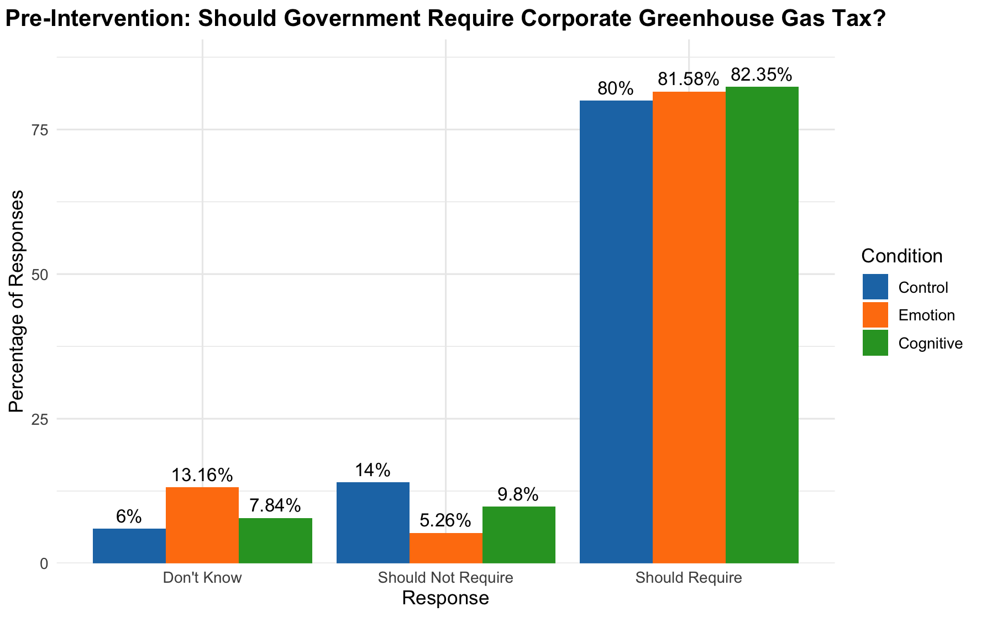

Slide 10
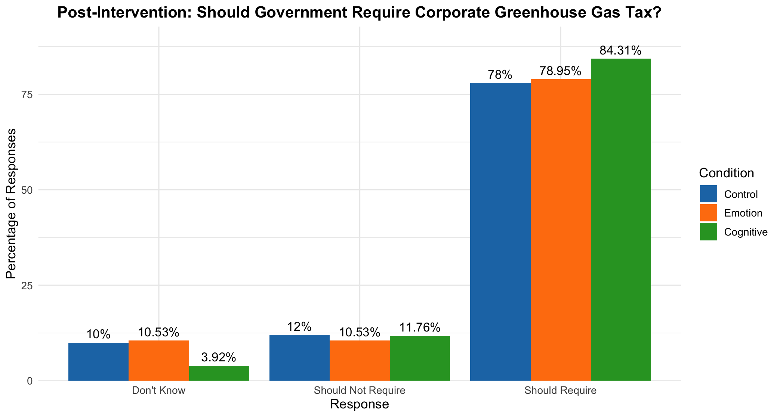

Slide 11
Next Steps for Public Perception and Opposition to Climate Change and Adaptation Policies
Explore Data
Data Preprocessing
Data Engineering
Data Analysis
T-Tests
Anova
Random-Effects Regression
Literature Review
Additional
Large Surveys

Slide 12

International Collective Action on Climate Change

Slide 13
Research Questions
Why has international climate regime failed?
Why has international community failed in generating sufficient environmental collective action to prevent climate change?
What are primary barriers to achieving international agreements on climate change mitigation?
How do geopolitical interests shape effectiveness of international climate negotiations?
What role do non-state actors such NGOs and MNCs play in facilitating or hindering global climate action?
How does economic dependency on fossil fuels affect countries' commitments to climate agreements?
What mechanisms can enhance compliance and enforcement of international climate treaties?
How do climate change policies vary between developed and developing countries?

Slide 14
Data and Methods
Data
Compliance with Climate Agreements
GHG Emission Levels
Fossil Fuel Dependency
Political and Institutional Factors
Global governance indicators
Technological Capacity
Technology Transfers
Climate Finance Fulfillment Index
Methods
Fixed Effects Model
GLMs with country clusters
Causal identification techniques
Survival analysis
Case studies

Slide 15
Next Steps:
Literature Review
Explore Data
Data Analysis
Fixed Effects Models

Slide 16
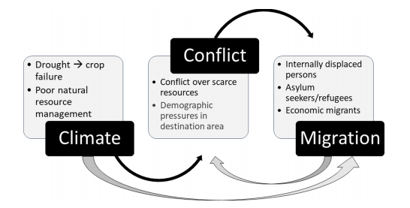
Climate Change-Conflict Nexus

Slide 17
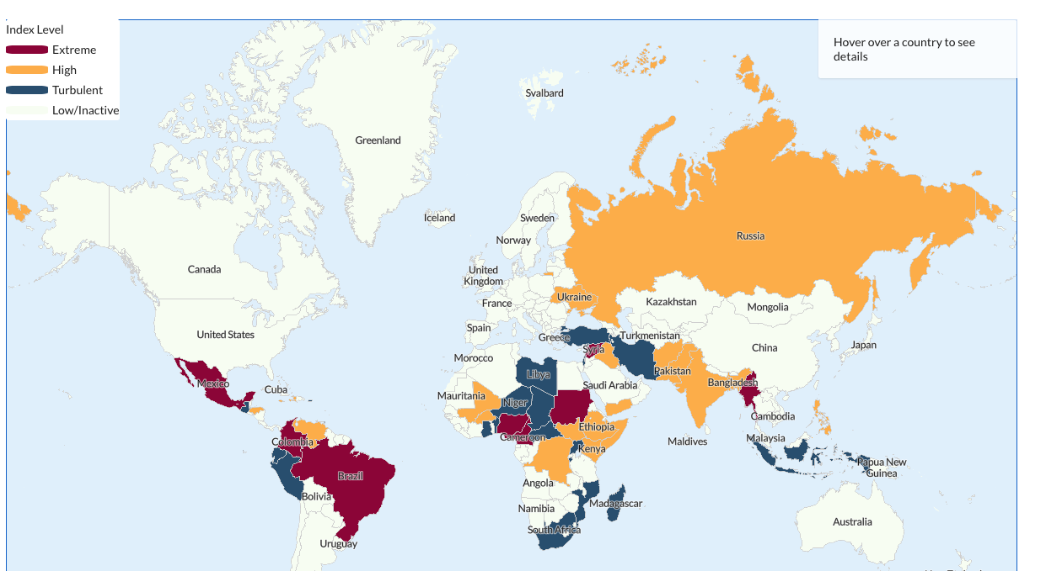

Slide 18
Research Questions
Does climate change cause conflict? What are causal mechanisms connecting climate change to conflict?
How does climate-induced migration influence regional stability and conflict dynamics?
How do different types of conflicts such relate to specific climate change impacts?
What is impact of climate change on frequency and intensity of violent protests?
What are socioeconomic impacts of climate change on vulnerable communities?

Slide 19
Data and Methods
CRU (Climatic Research Unit) for temperature and precipitation(accessable via Google Earth).
Emergency Events Database (EM-DAT) for natural disasters
Satellite-derived climate anomalies.
Climate change indicators
Methods
Panel data analysis
GIS analysis
Case Study: e.g. Darfur
Conflict data
Armed Conflict Location & Event Data Project (ACLED)
UCDP/PRIO Armed Conflict Dataset

Slide 20
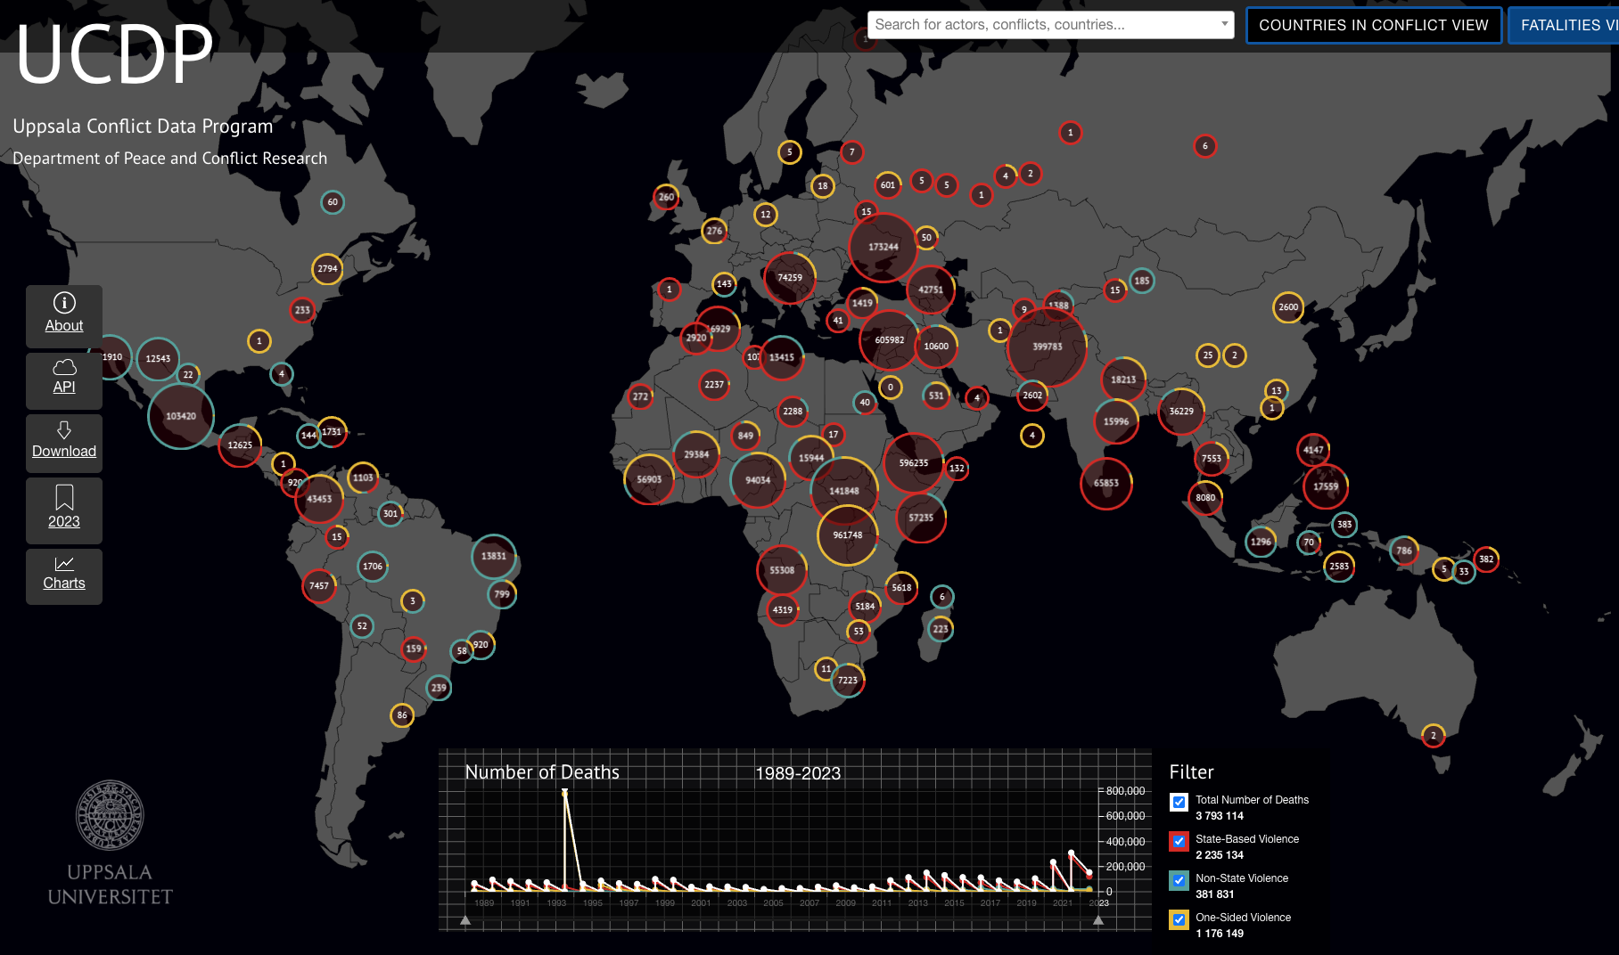

Slide 21
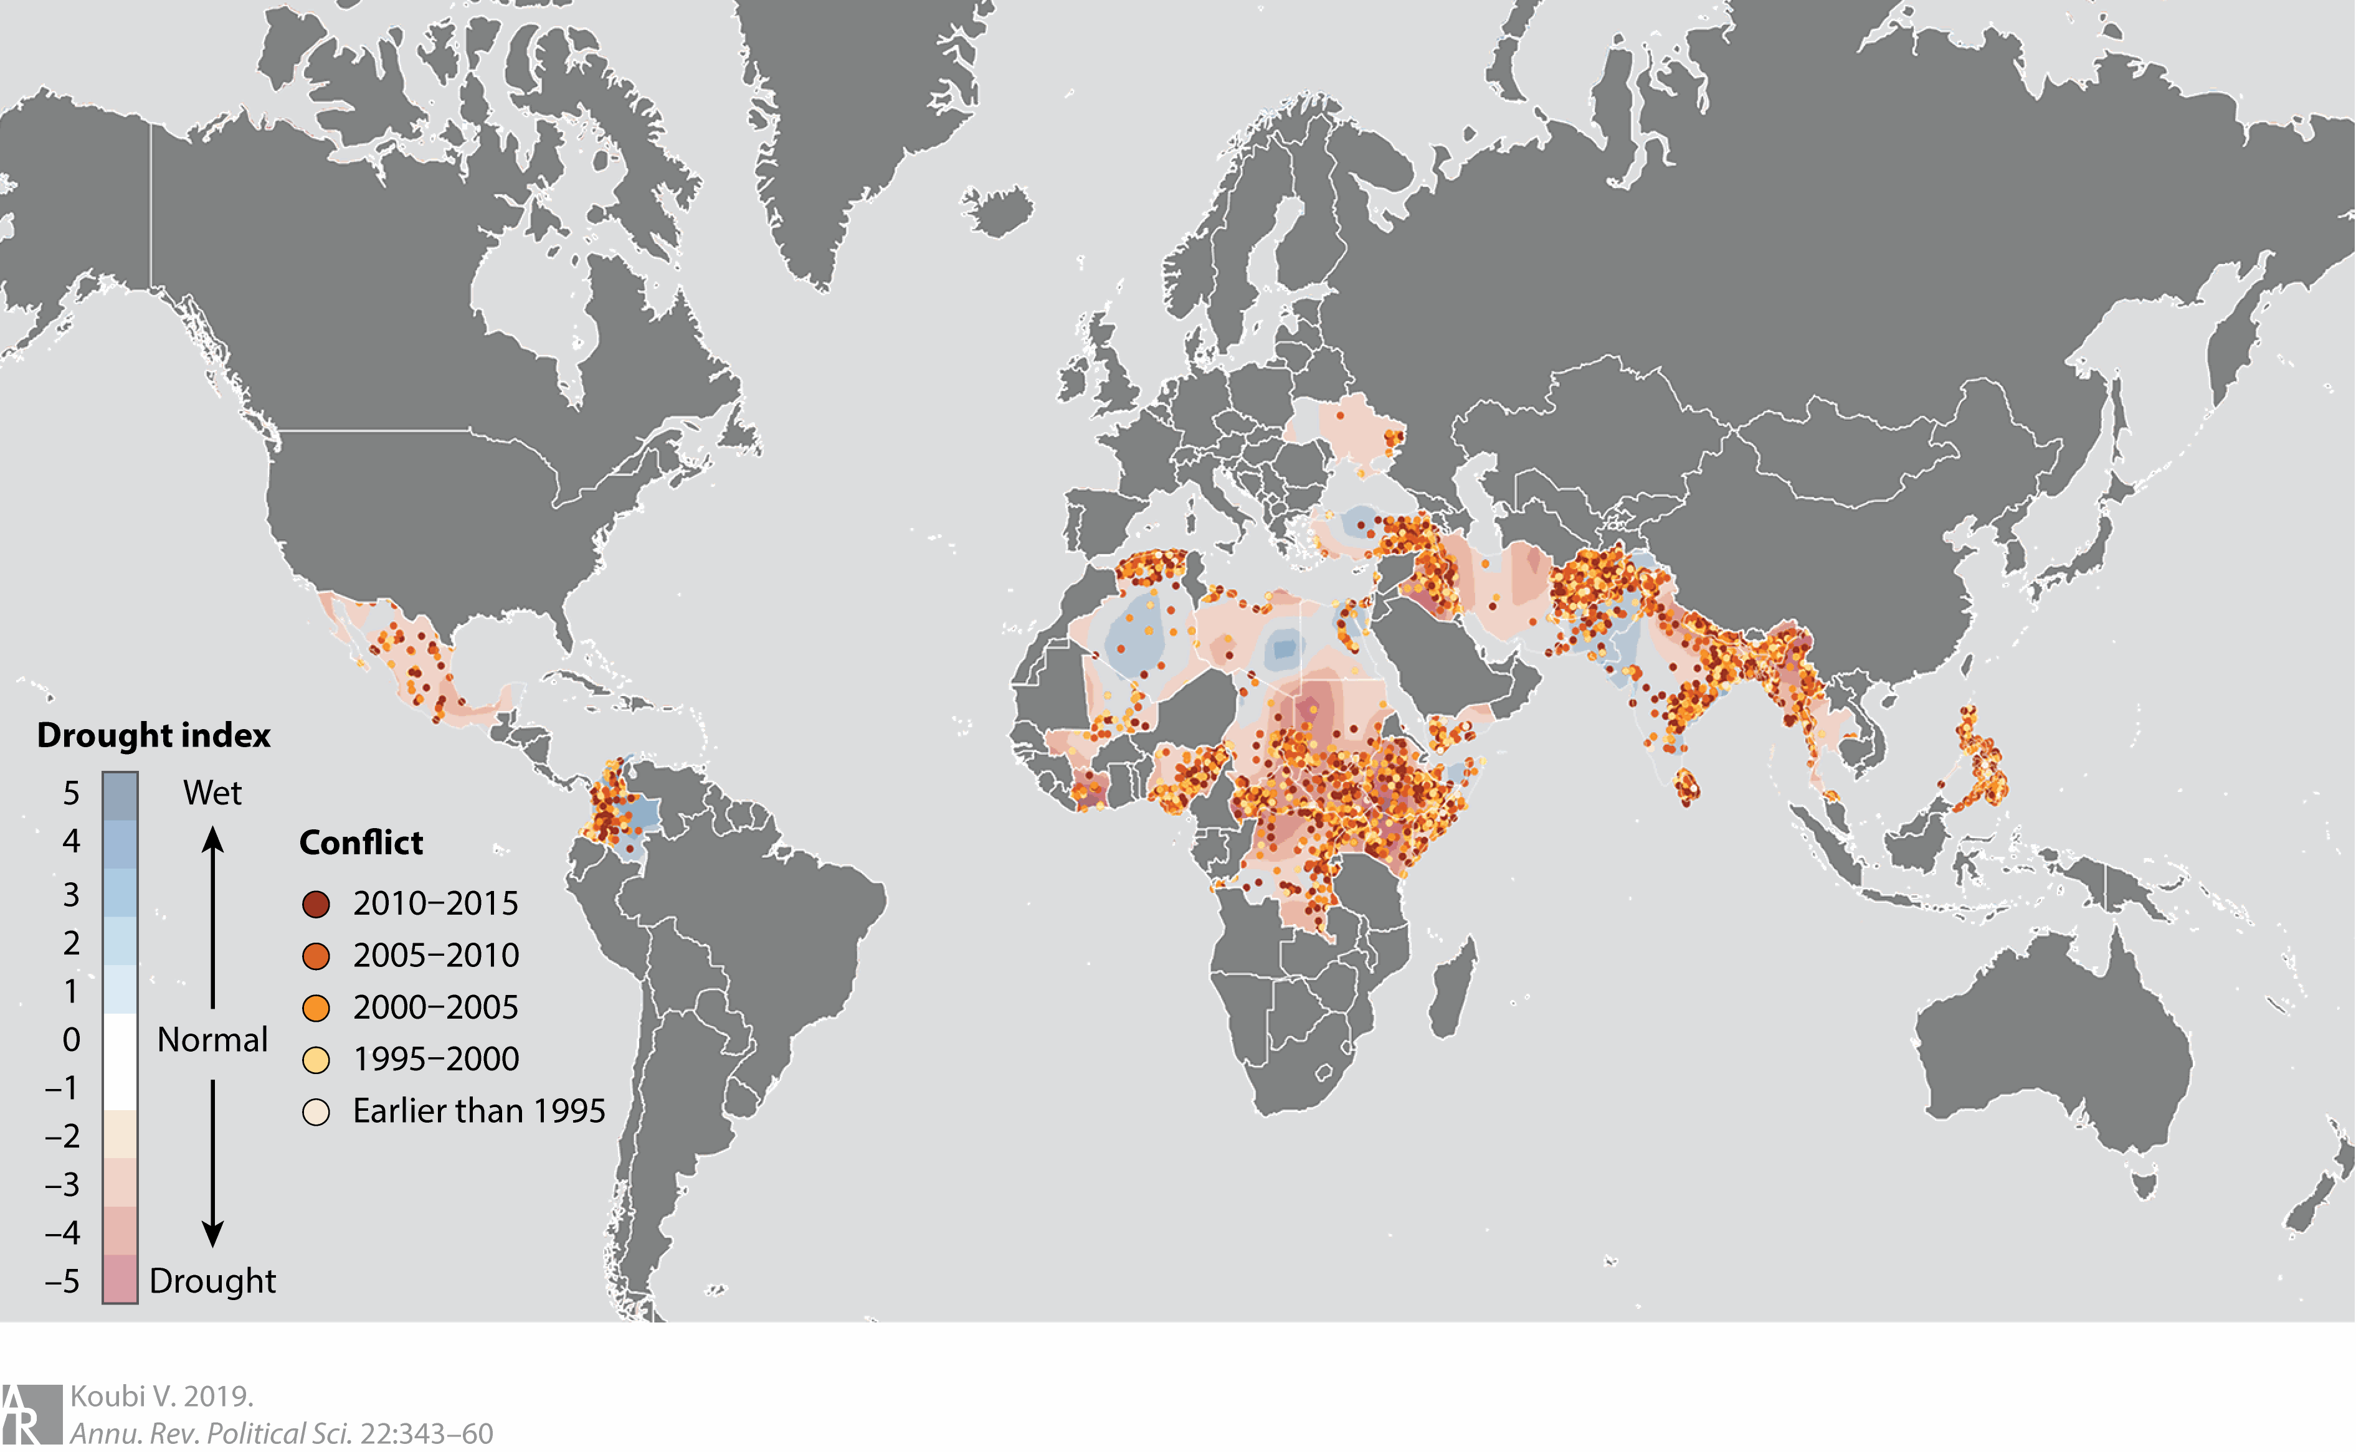

Slide 22
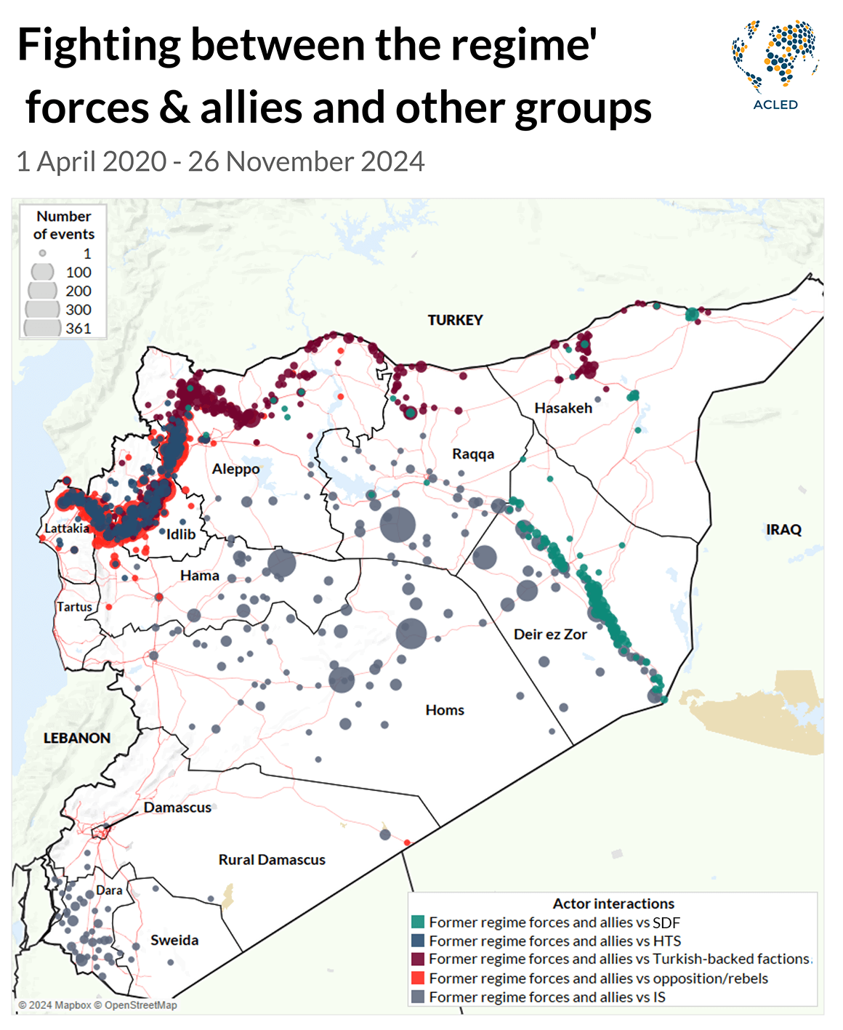
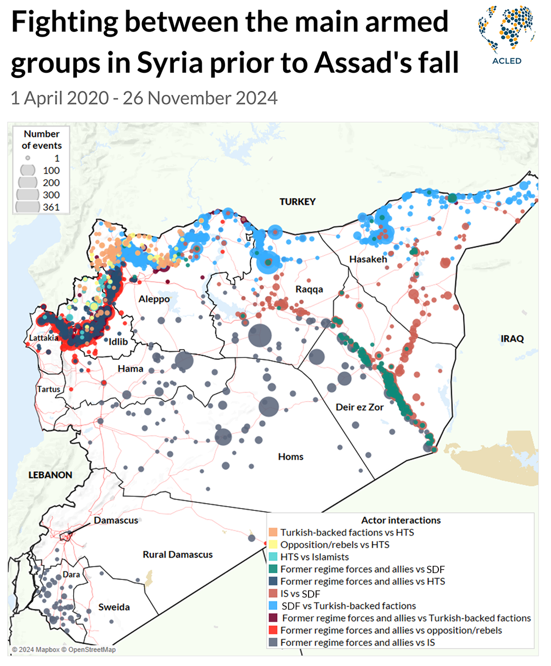

Slide 23
Next Steps
Choose your area
1
Join Discord Group
2
Google Doc
3
Appointment for additional assistance
4

